Slide 1

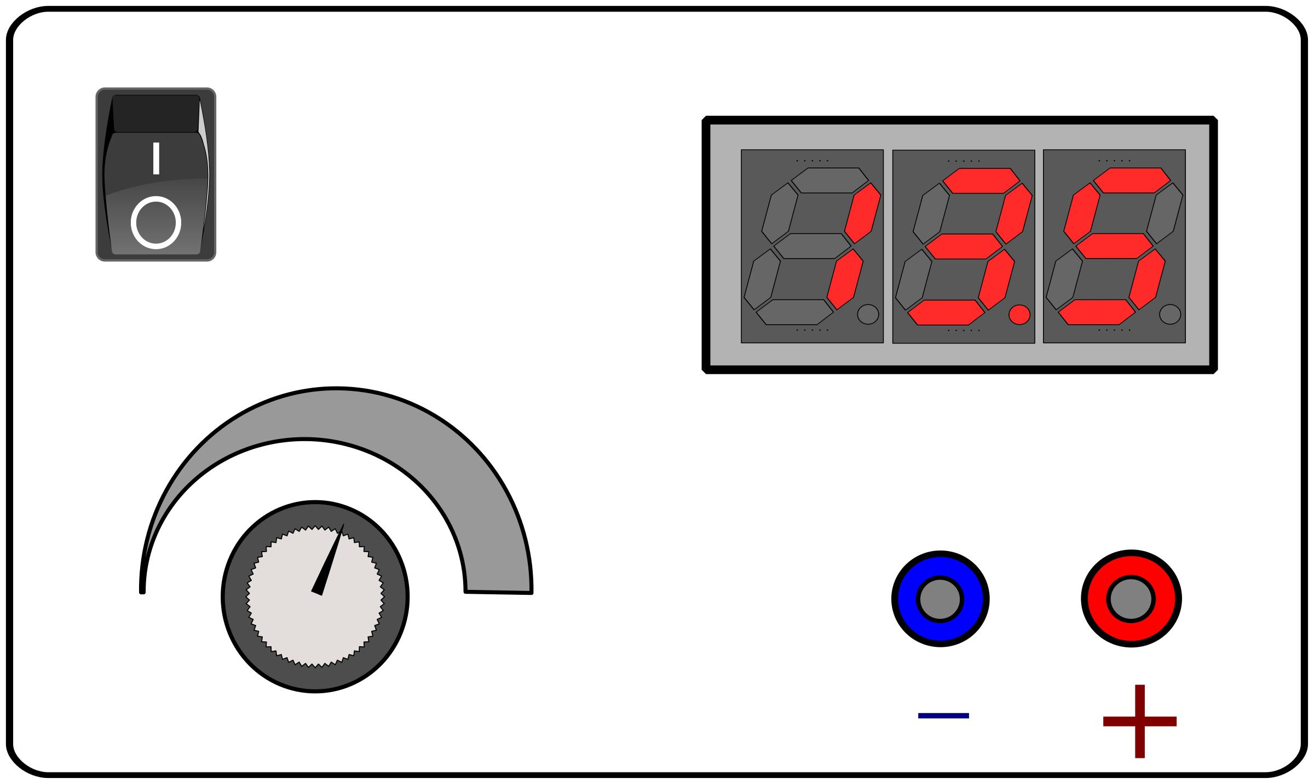
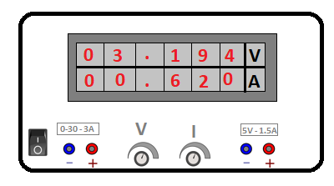
Lab Power Supply V2
Authors name – Paul Potolias
Department of Information and Electronic Engineering
Thessaloniki 54248
Email id – paulos195@gmail.com
2 May 2023
Page 1 of 26

Slide 2


Content
Lab Power Supply
Subcircuits of PowerSupply
Compoments analysis
Current & Voltage outputs
Altium Designer results
Powered by:
2 May 2023
Page 2 of 26

Slide 3
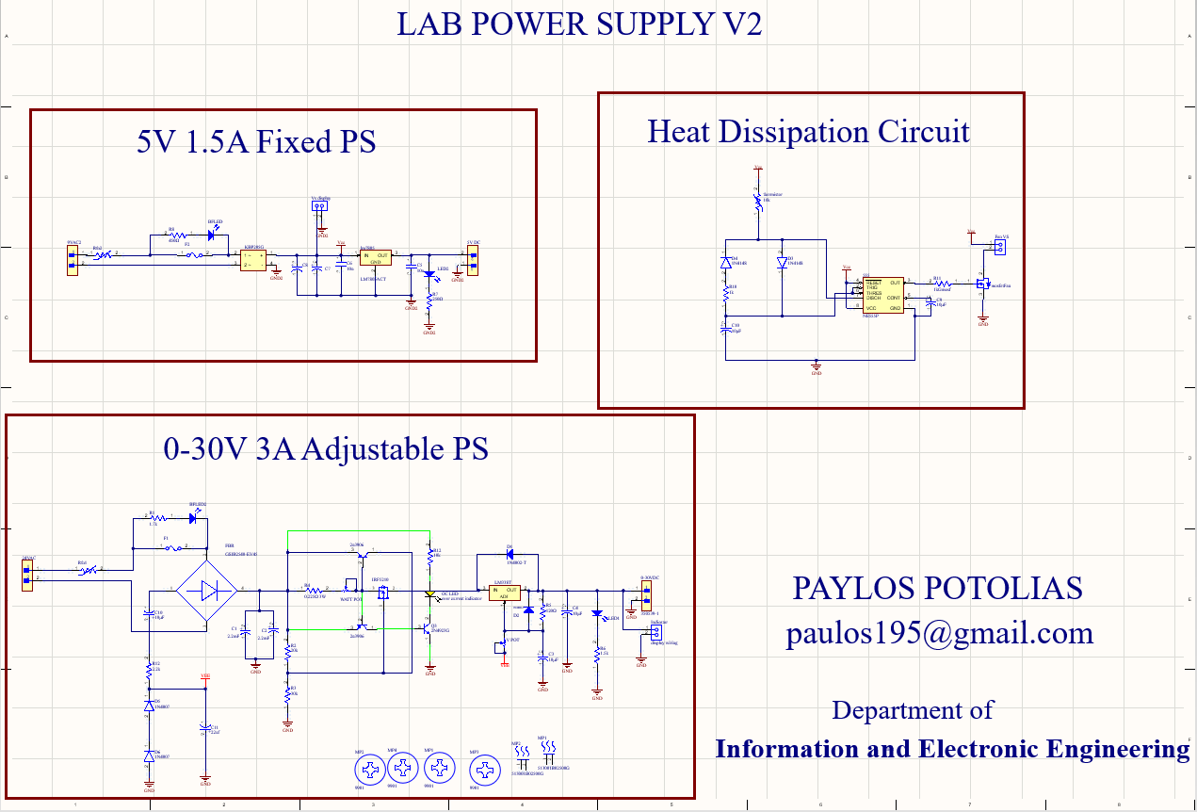
Consist of 3 subcircuits
PS 0-30V 3A
Fixed PS 5V 1.5A
Heat Dissipation Fan Circuit
2 May 2023
Page 3 of 26

Slide 4
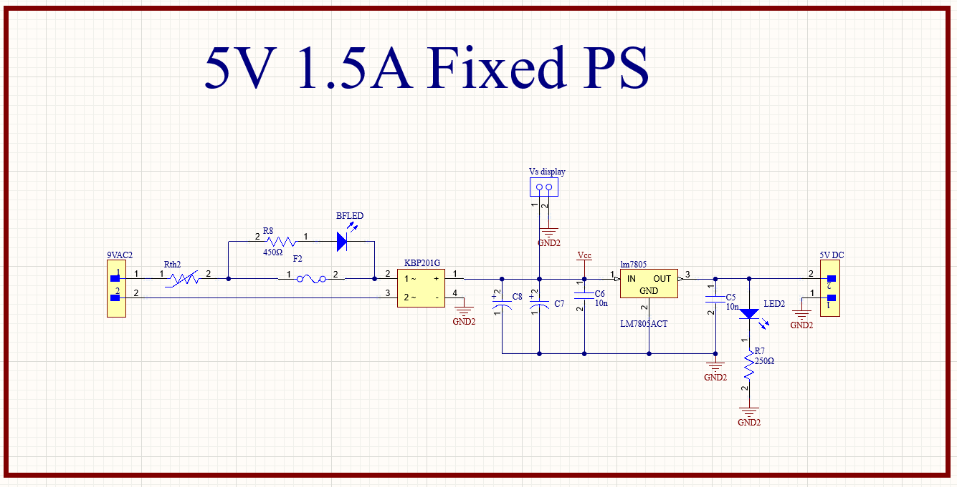
5V PS Part 1 of 11
NTC Surge Protector
Blown fuse indicator
On LED Indicator
2 May 2023
Page 4 of 26

Slide 5
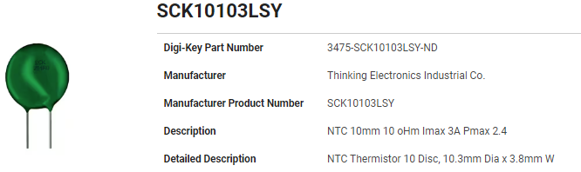
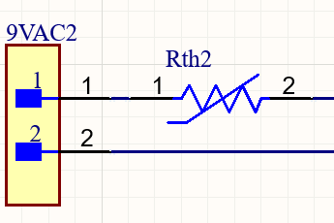

5V PS Part 2 of 11
NTC Surge Protector
SCK10103LSY
At 25°C
3A max
2.4W max
https://www.digikey.com/en/products/detail/allied-components-international/SCK10103LSY/16674206
Useful equation
$$\frac{V_{AC2}}{R_{th2}}=Imax$$
peak inrush current
at 25°C = 1.2A
2 May 2023
Page 5 of 26

Slide 6
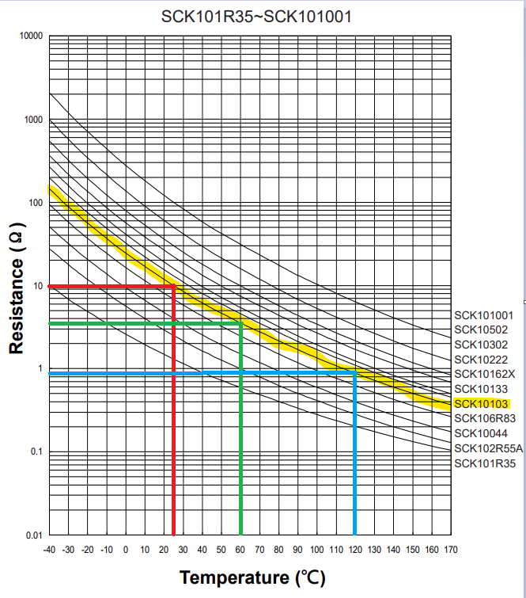
Temperature coefficient
5V PS Part 3 of 11
°C | Ω
25 | 10
60 | 3
120 | 0.9
2 May 2023
Page 6 of 26

Slide 7
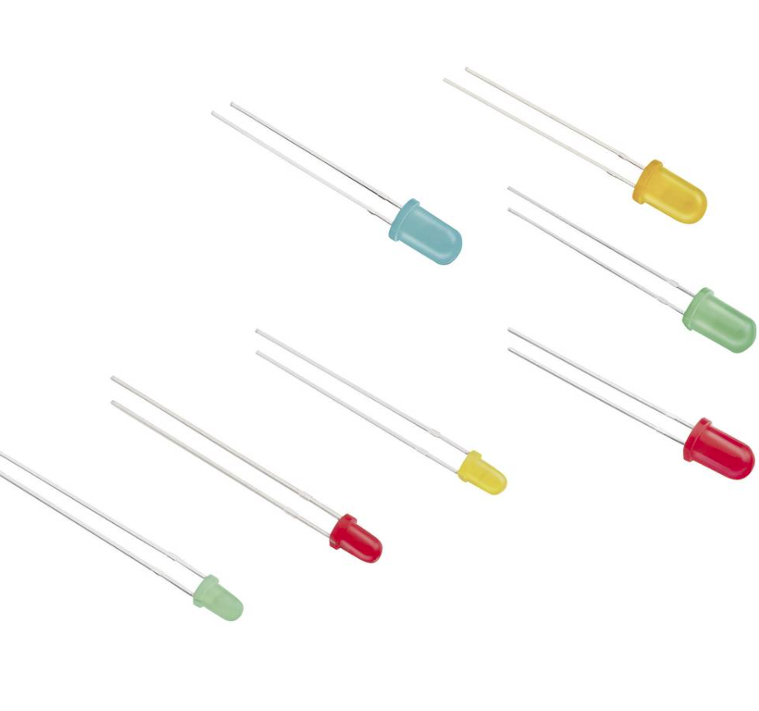
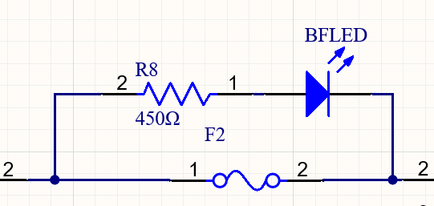
5V PS Part 4 of 11
Blown fuse indicator
1/4W Resistor
1.7 A Fuse
https://octopart.com/151031ss04000-wurth+elektronik-29717802?r=sp
2 May 2023
Page 7 of 26

Slide 8
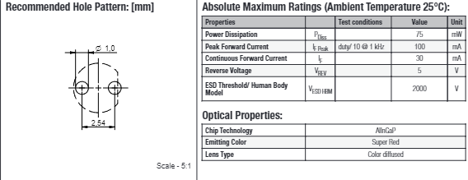

5V PS Part 5 of 11
BFLED Characteristics
IF = 30mA
RV = 5V
R= 450Ω 1/4 W
https://octopart.com/datasheet/151031ss04000-wurth+elektronik-29717802
Simple equation
$\frac{VAC2}{ILED} =R8$
Resistor value
450Ω
2 May 2023
Page 8 of 16

Slide 9
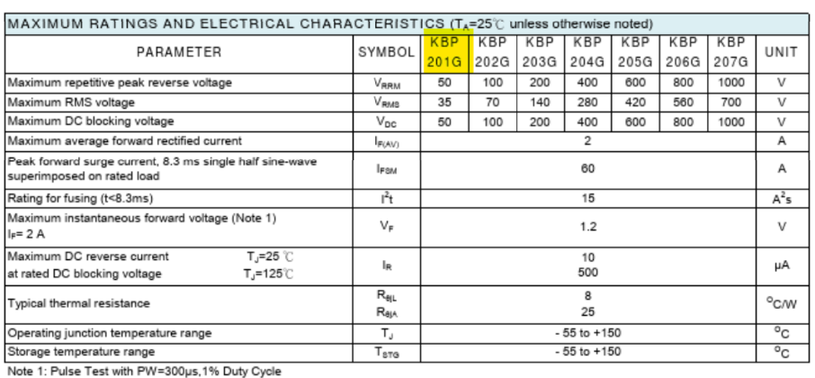
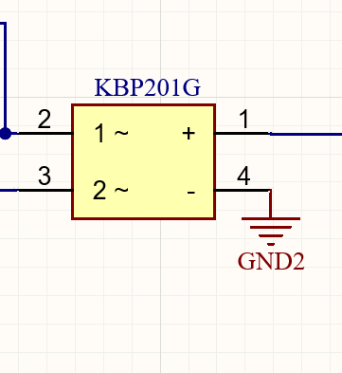
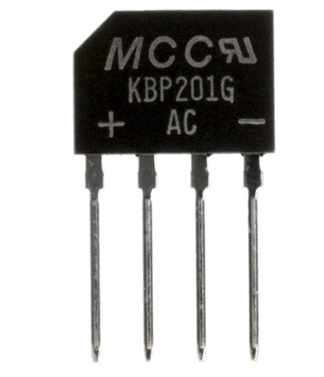
αα
5V PS Part 6 of 11
KBP201G Characteristics
VRMS 35V
VDC 50V
IF 2A
VF 1.2V
https://datasheetspdf.com/pdf/621458/TaiwanSemiconductorCompany/KBP205G/1
Useful info
Current surge must
be less than 2A in order to work safely
https://www.digchip.com/datasheets/parts/datasheet/284/KBP201G-BP.php
2 May 2023
Page 9 of 26

Slide 10
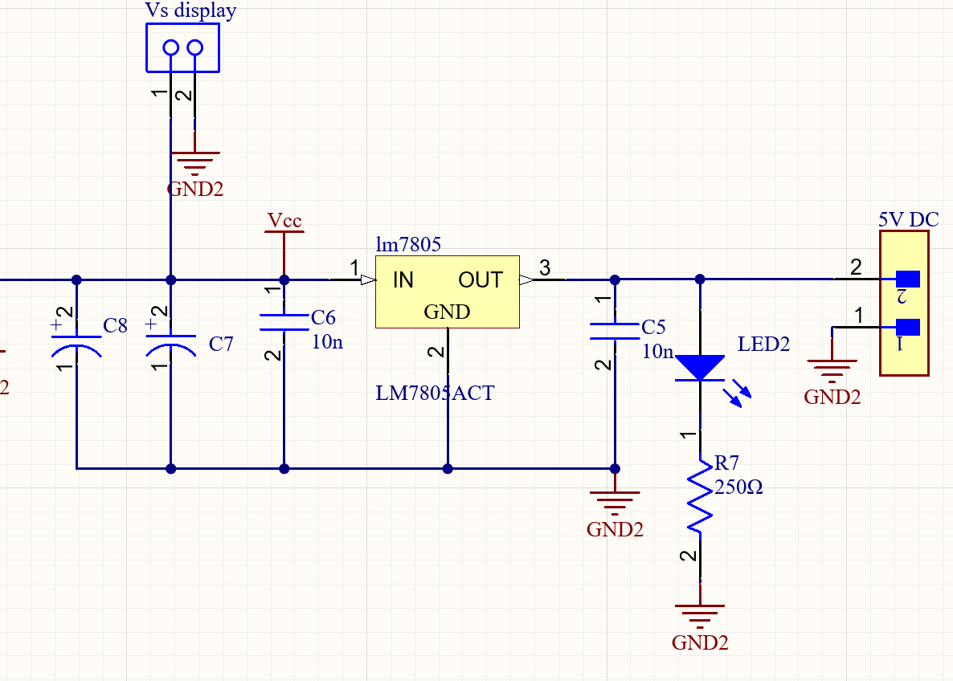
5V PS Part 7 of 11
Regulated Circuit
Smoothing cap
2.2uF each
Lm7805
On led indicator (green 20mA)
Output Voltage stable at 5V
2 May 2023
Page 10 of 26

Slide 11
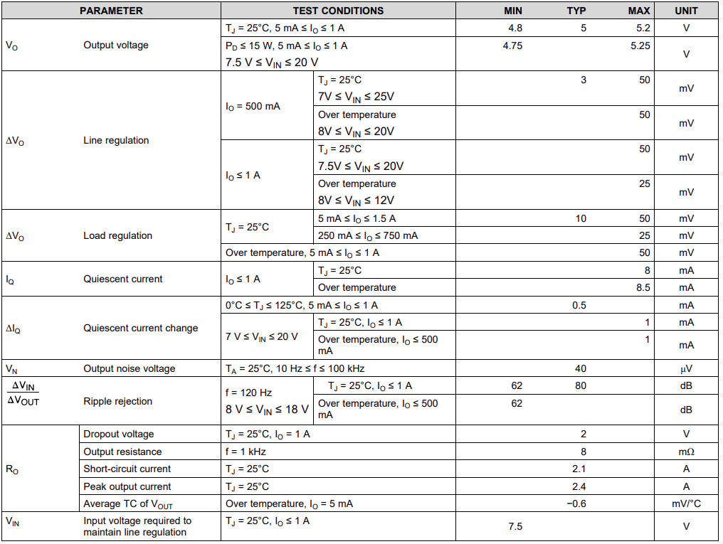
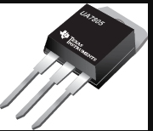
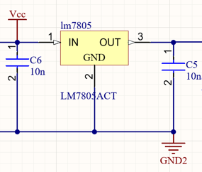
5V PS Part 8 of 11
LM7805 Characteristics
Output Current up to 1.5 A
• Output Voltage stable 5V
• Internal Thermal Overload, Short-Circuit and SOA Protection
•Package TO-220
https://www.ti.com/lit/ds/symlink/lm7800.pdf
2 May 2023
Page 12 of 26

Slide 12
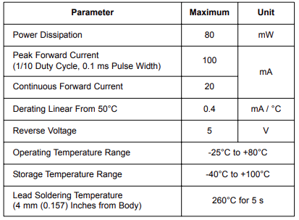
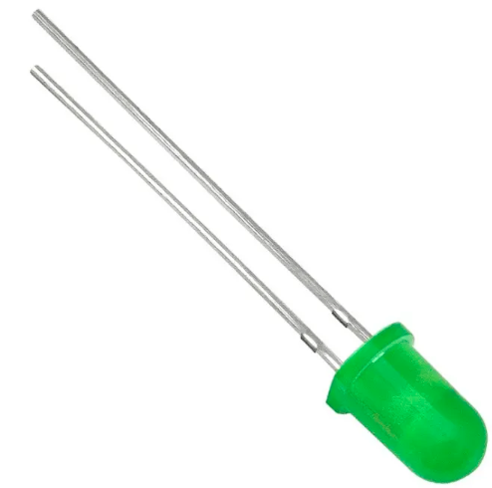

5V PS Part 9 of 11
LED2 Characteristics
V_{f} 2.5V
I_{f} 20mA
R_{V} 5V
Resistor= 250Ω 1/4 W
https://www.farnell.com/datasheets/1498852.pdf
2 May 2023
Page 12 of 26

Slide 13
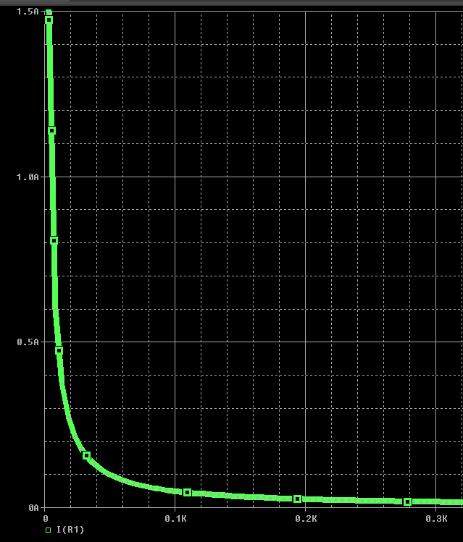
5V PS Part 10 of 11
Current Output
Ω | mΑ
3.3334 | 1.5Α
50 | 166
100 | 49.98
150 | 33.3
200 | 24.98
250 | 19.98
300Ω | 16
2 May 2023
Page 12 of 26

Slide 14
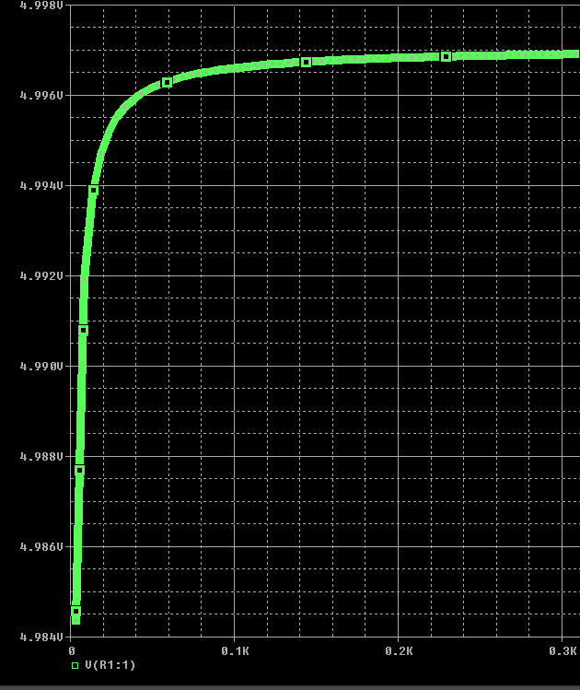
5V PS Part 11 of 11
Voltage Outputt
Ω | V
3.3334 | 4.9844
50 | 4.9962
100 | 4.9966
150 | 4.9968
200 | 4.9968
250 | 4.9969
300Ω | 4.9969
2 May 2023
Page 12 of 26

Slide 15
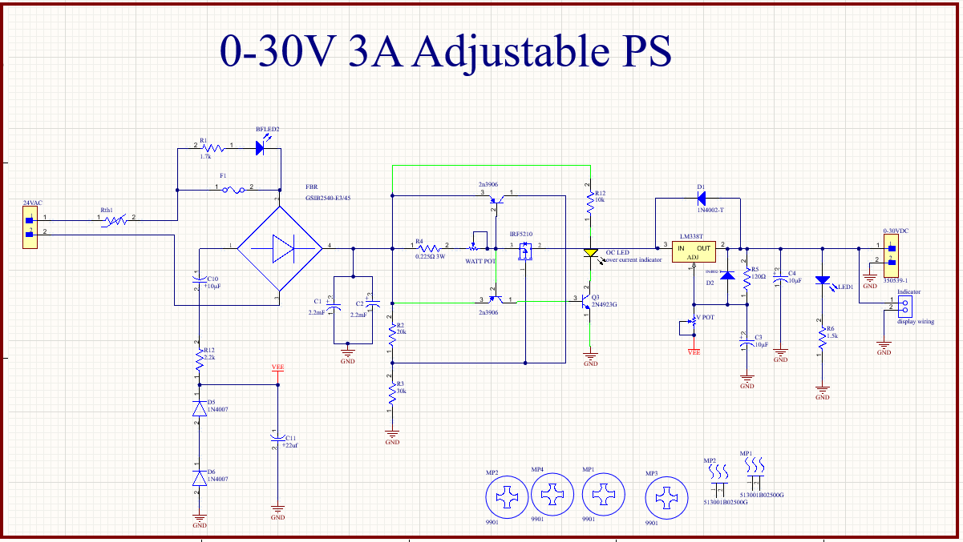
NTC Surge Protector
Current limiter
overcurrent indicator
Blown fuse indicator
On LED Indicator
Display panel
2 May 2023
Page 11 of 26

Slide 16
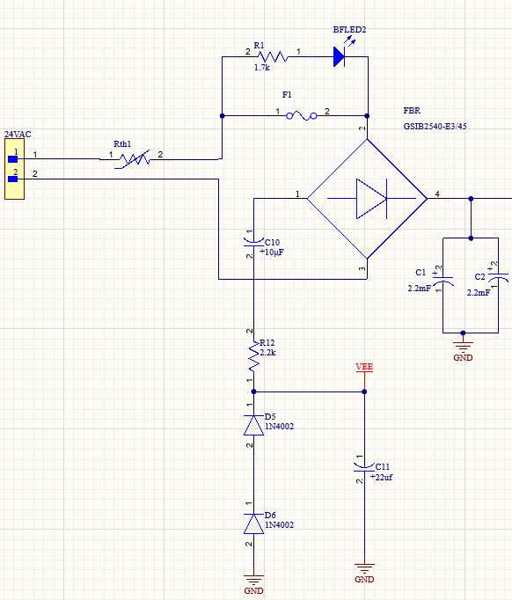
Rectifying circuit
NTC Surge Protector
Blown fuse indicator
Negative voltage refference
2 May 2023
Page 12 of 26

Slide 17
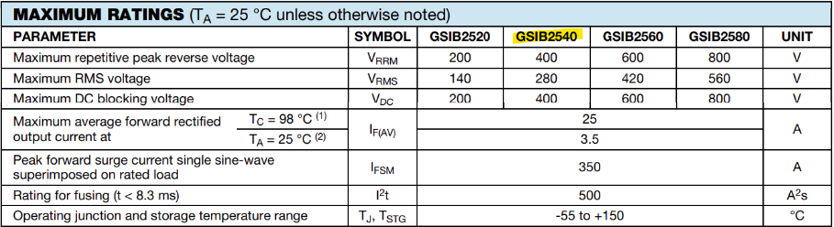
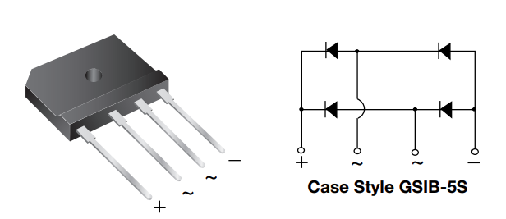
GSIB2540
V_{P} 400V
I_{F} 3.5A
Negative voltage refference
NOTES
(1) Unit case mounted on aluminum plate heatsink
(2) Units mounted on PCB without heatsink
2 May 2023
Page 12 of 26

Slide 18
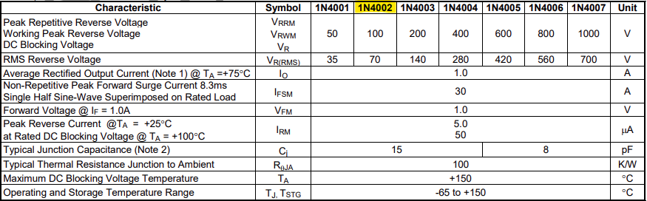
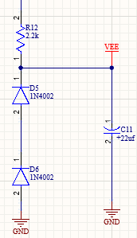

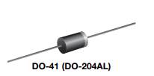
Diode 1n4002
V_{P} = 100V
Resistor 1/4W 2.2KΩ
Voltage drop 0.6V
I_{F} = 1A
Negative voltage refference
https://www.diodes.com/assets/Datasheets/ds28002.pdf
2 May 2023
Page 12 of 26

Slide 19
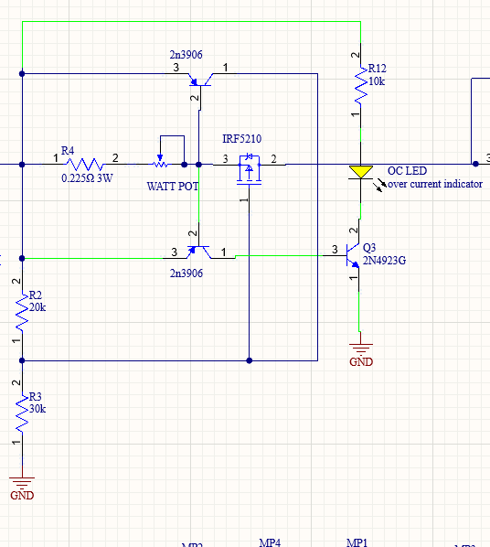
Current limiter
PNP Transistor
P channel Mosfet
overcurrent indicator
2 May 2023
Page 12 of 26

Slide 20
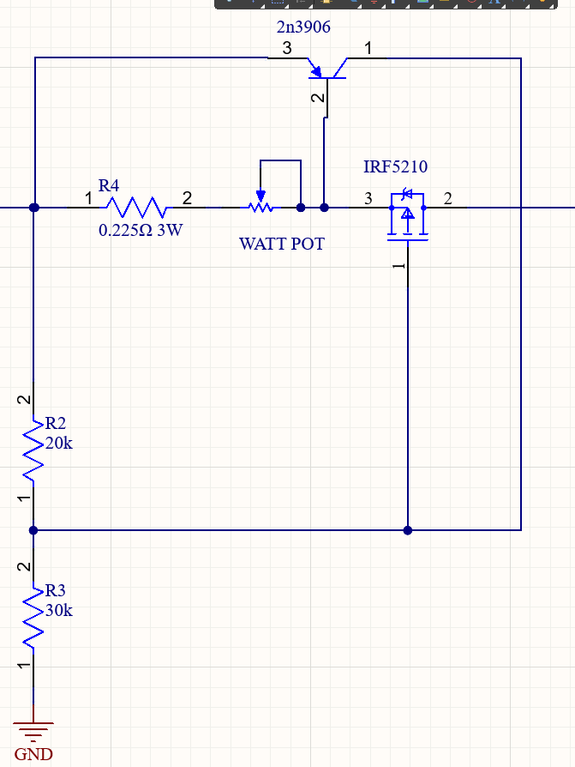
RESISTORS
R4 sensor
R2,R3 Gate Drivers
WATT POT adjustable sensor
2n3906 PNP transistor current driver
2 May 2023
Page 12 of 26

Slide 21
Starting current flow
Current Flow
2 May 2023
Page 12 of 26

Slide 22
Starting current flow
Current creates a voltage drop on resistor
which makes the PNP transistor conductive
0.7 V
Current Flow
2 May 2023
Page 12 of 26

Slide 23
Current Flow
Starting current flow
Current creates a voltage drop on resistor
which makes the PNP transistor conductive
current flowing from PNP transistor to the driving resistor net
Current Flow
2 May 2023
Page 12 of 26

Slide 24
Starting current flow
Current creates a voltage drop on resistor
which makes the PNP transistor conductive
current flowing from PNP transistor to the driving resistor net
current flow to the circuit
Current Flow
2 May 2023
Page 12 of 26

Slide 25
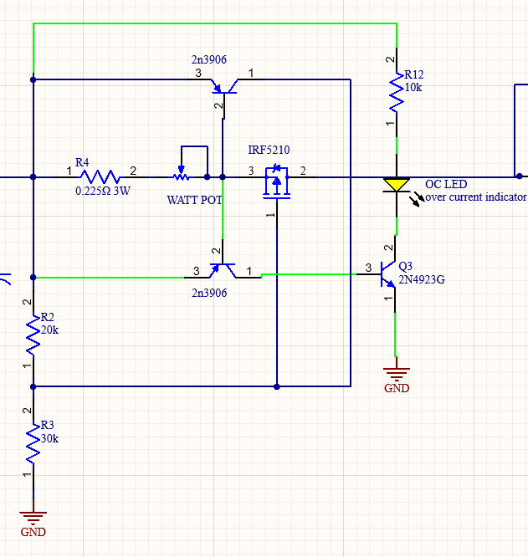
2 May 2023
Page 12 of 26

Slide 26
Starting overcurrent
2 May 2023
Page 12 of 26

Slide 27
Starting overcurrent
Makes enough voltage drop for the 2n4923G to
conduct
2 May 2023
Page 12 of 26

Slide 28
Starting overcurrent
Makes enough voltage drop for the 2n4923G to
conduct
the rest of the available current flowing to the GND
from 2n4923G
2 May 2023
Page 12 of 26

Slide 29
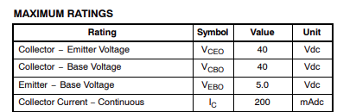
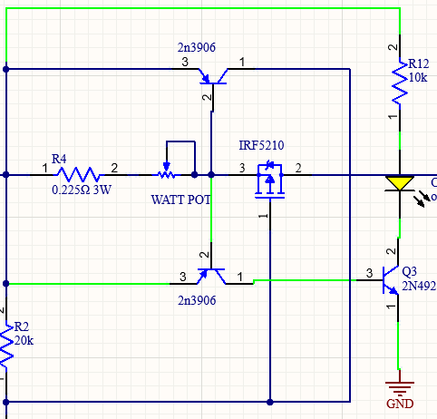
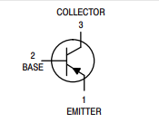
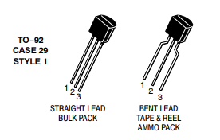
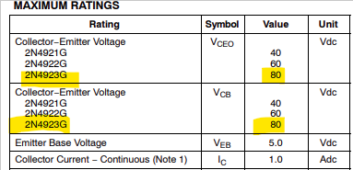
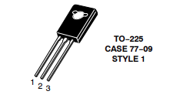
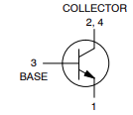
2N3906
VBE 0.65
VCE 40V
IC 200mA
2n4923G
VBE 0.6V
VCE 80V
IC 1A
https://www.onsemi.com/pdf/datasheet/2n3906-d.pdf
https://www.onsemi.com/pdf/datasheet/2n4921-d.pdf
2 May 2023
Page 12 of 26

Slide 30
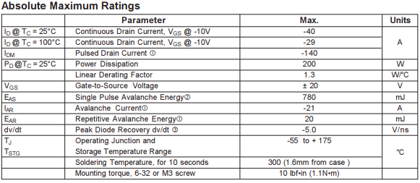
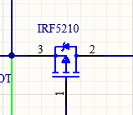
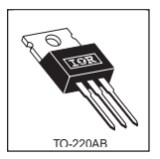
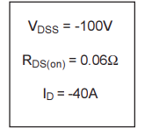
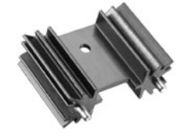

IRF5210
V_{GS} -10V
I_{D} 40A (25°C)
I_{D} 29A (100°C)
R_{DS(on)} 60mΩ
P_{D} 1.3W/°C
R_{θJA} 62°C
Useful equation
$$\frac{MAX(TJ)−���A}{RθJA}$$
https://www.infineon.com/dgdl/Infineon-IRF5210-DataSheet-v01_01-EN.pdf?fileId=5546d462533600a4015355e3576b198b
https://gr.mouser.com/datasheet/2/2/Aavid_01112021_Board_Level_Cooling_Extruded_5000-1953731.pdf
2 May 2023
Page 12 of 26

Slide 31
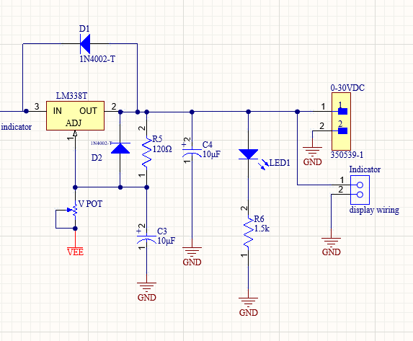
Voltage Regulator
0-30V
On indicator
Voltmeter Display
LM338T Voltage regulator
Reverse Voltage protection
2 May 2023
Page 12 of 26

Slide 32
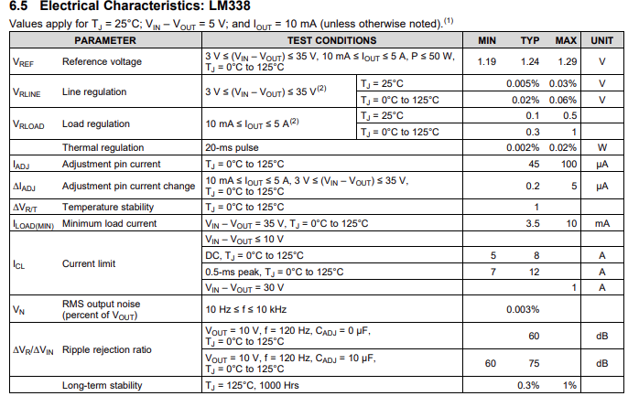
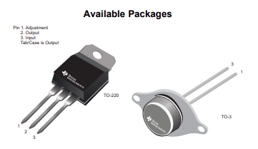
Voltage Regulator
O -220
V_{REF} 1.24
I_{MAΧ} 5Α
Internal Thermal protection
(1) 25 W for the TO-220 (NDE)
package. Power dissipation is specified at these values up to 15-V input-output differential. Above 15-V differential, power dissipation is
limited by internal protection circuit.
(2) Regulation is measured at a constant junction temperature, using pulse testing with a low duty cycle. Changes in output voltage
due to heating effects are covered under the specifications for thermal regulation.
2 May 2023
Page 12 of 26

Slide 33
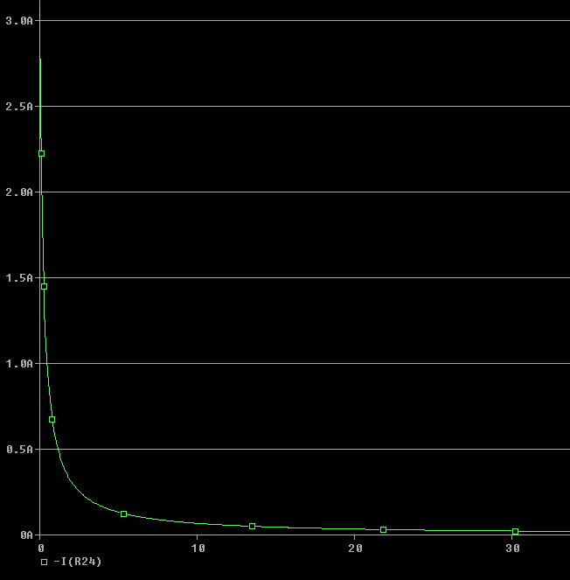
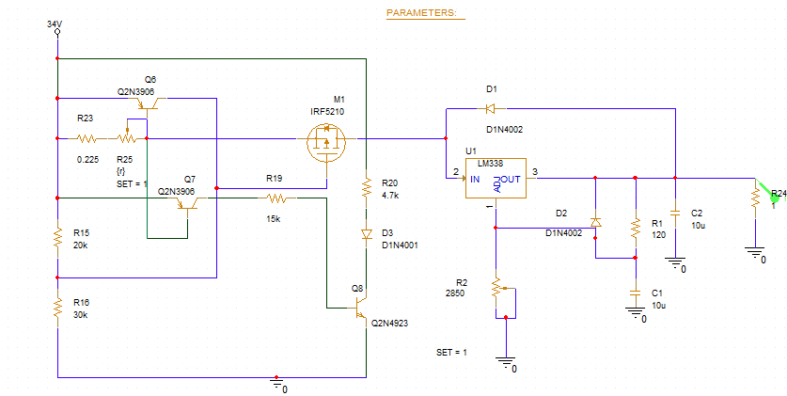
Current Limiter
non linear
225mΩ - 10KΩ
0-3A
2 May 2023
Page 12 of 26

Slide 34

2 May 2023
Page 12 of 26

Slide 35


Final Altium result
2 May 2023
Page 12 of 26

Slide 36
References & software
 | Software | references
1 | PsPice AD 2022 | Ανανεώσιμες Πηγές Ενέργειας και εφαρμογές των Ηλεκτρονικών Ισχύος, 2η έκδοση
2 | Altium Designer 23.2.1 Build 34 | ΣΥΓΧΡΟΝΕΣ ΕΦΑΡΜΟΓΕΣ ΑΝΑΛΟΓΙΚΩΝ ΗΛΕΚΤΡΟΝΙΚΩΝ
3 | Office-PowerPoint | Malvino's Electronic Principles 8 edition
****THANK YOU****
2 May 2023
Page 12 of 26

